Slide 1
Welcome to
Our Sunday School
We’ll start at 9:07
visit OurSundaySchool.com for more about our class

Slide 2
Today’s class (pages 79-86)
Philippians 1:22-24

Slide 3
Philippians 1:22-24 (CSB)
Now if I live on in the flesh, this means fruitful work for me; and I don’t know which one I should choose. I am torn between the two. I long to depart and be with Christ—which is far better—but to remain in the flesh is more necessary for your sake.

Slide 4
Today’s class (pages 79-86)
Philippians 1:22-24

Slide 5
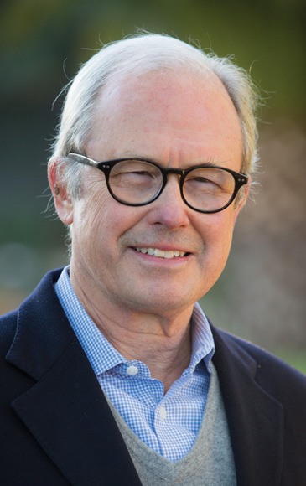
Dr. G. Walter Hansen Paul did not view his work as a grim duty or burdensome obligation, but as the fruitful out- flowing of God’s faithful in-working.

Slide 6
Today’s class (pages 79-86)
Philippians 1:22-24

Slide 7
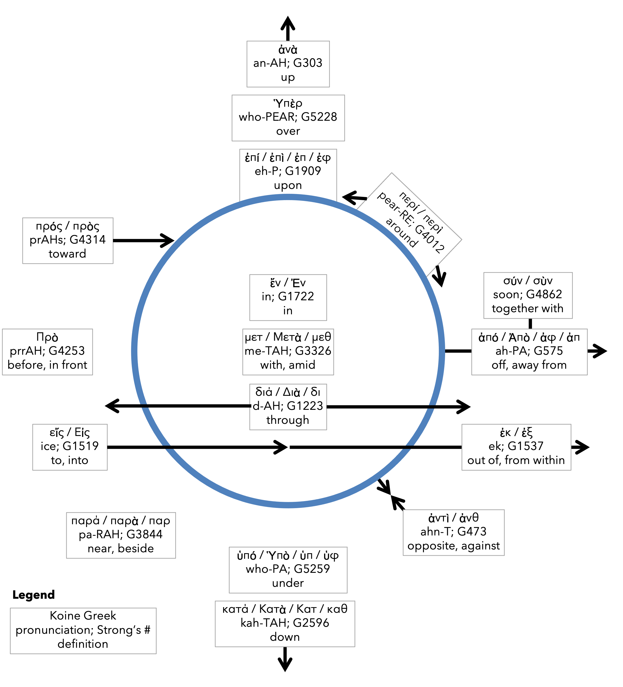
Preposition circle (page 11)

Slide 8
Today’s class (pages 79-86)
Philippians 1:22-24

Slide 9
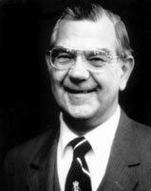
Dr. Ralph P. Martin The agitation of Paul’s mind is clearly to be seen in the broken syntax of his writing.

Slide 10
Today’s class (pages 79-86)
Philippians 1:22-24

Slide 11
Dr. G. Walter Hansen The way both infinitives (to depart... to be) share one article in Greek unites the two together. When Paul thinks of death, he thinks of his union with Christ.

Slide 12
Today’s class (pages 79-86)
Philippians 1:22-24

Slide 13
Dr. G. Walter Hansen Such a positive view of suffering and death would have been helpful for Paul’s first-century readers who were also facing persecution and possible execution for their faith in Christ.

Slide 14
Today’s class (pages 79-86)
Philippians 1:22-24

Slide 16
Today’s class (pages 79-86)
Philippians 1:22-24

Slide 17
Dr. G. Walter Hansen Paul was willing to delay crossing the finish line in his own race in order to serve the needs of the believers in Philippi.

Slide 18
Today’s class (pages 79-86)
Philippians 1:22-24

Slide 20
Today’s class (pages 79-86)
Philippians 1:22-24

Slide 21
Prayer Time
Write down your prayer requests (on the Weekly Update or in the comments)
Lean in, engage, and pray for someone not with you
Go worship

Slide 22
Today’s class (page 16)
Preparing for Philippians 1:1-30
Pray with others
Hear with others
Think with others
Study with others In class, as a table
Share with others
Invite others After class
In class, as a class

Slide 23
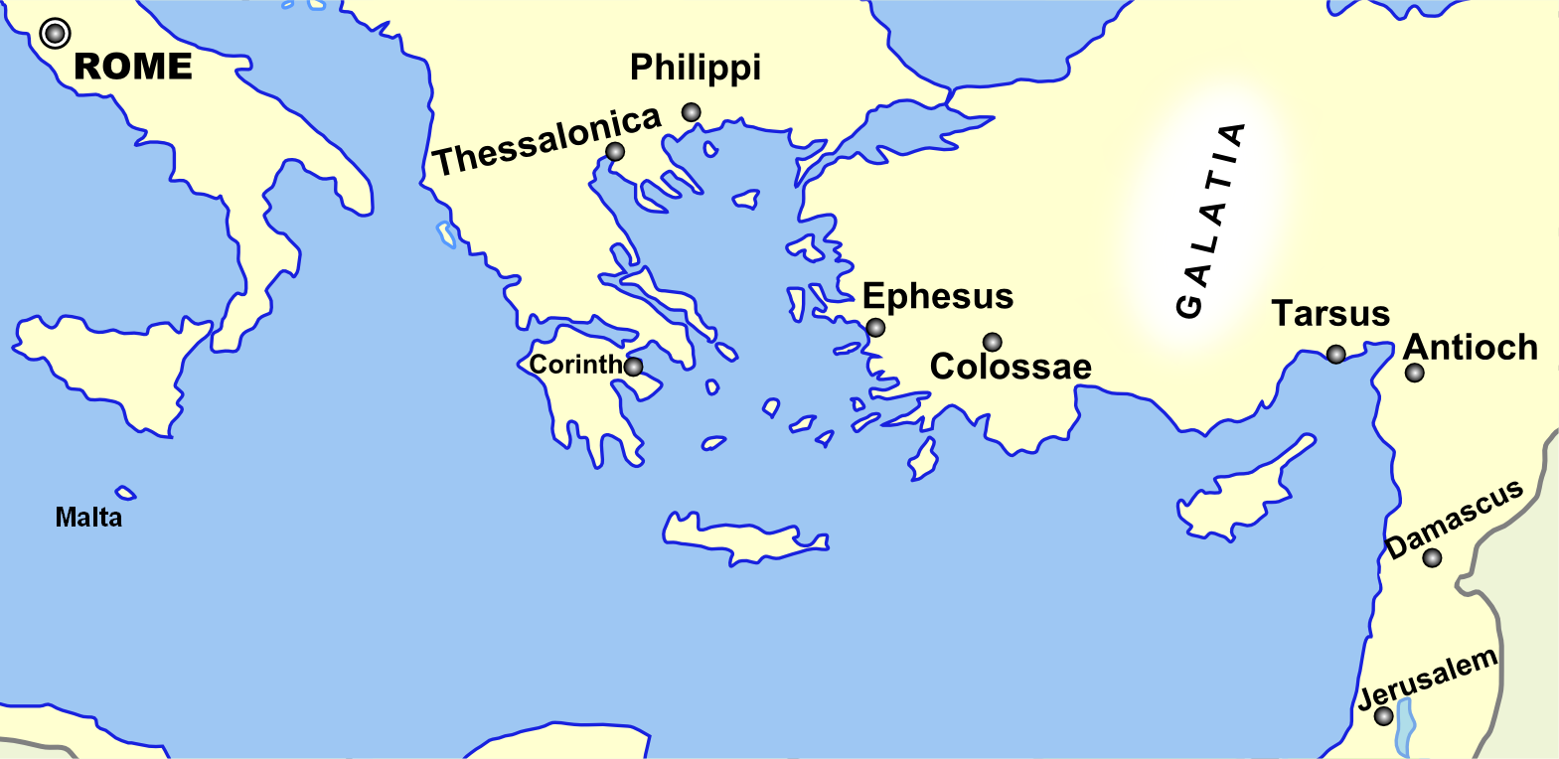
Monozigote. (2012). Broad Overview of Geography Relevant to Paul of Tarsus [Map]. Wikipedia.

Slide 24
Preposition circle (page 11)

Slide 25
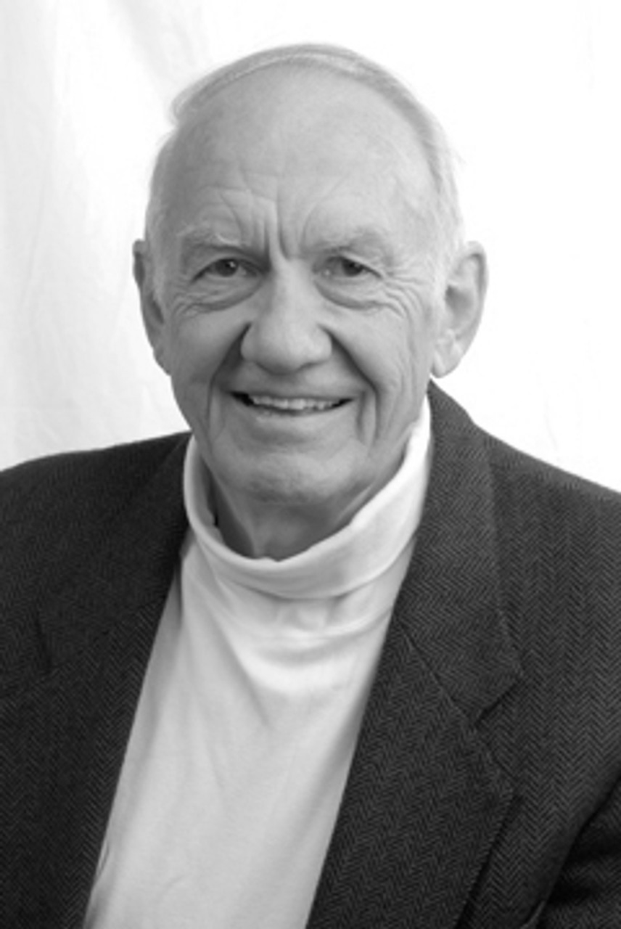
Dr. Gordon Fee …a distinguishable part of the whole, but as part of the whole, not above or outside it

Slide 26
Dr. G. Walter Hansen …a distinguishable part of the whole, but as part of the whole, not above or outside it

Slide 27
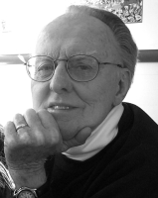
Dr. G. F. Hawthorne & Dr. Ralph P. Martin Paul can see it no other way: as the master was, so must the servant be.

Slide 28
Dr. Ralph P. Martin The agitation of Paul’s mind is clearly to be seen in the broken syntax of his writing.

Slide 29
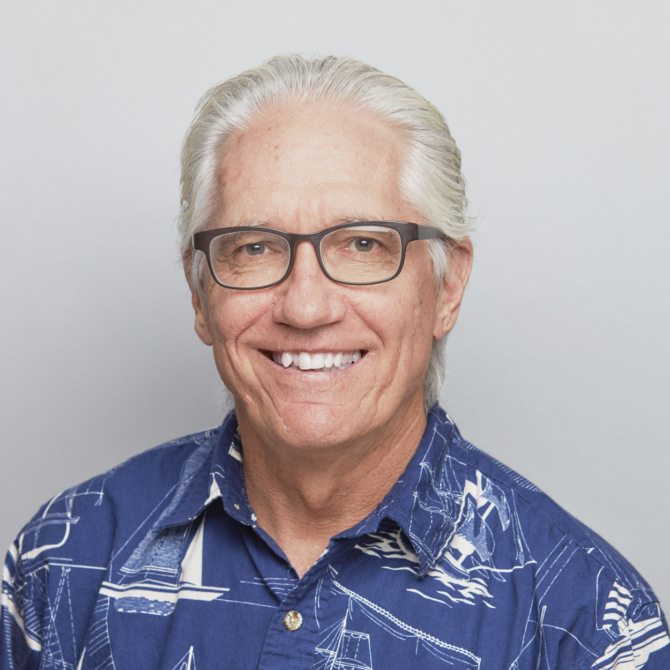
Dr. Joe Hellerman The pacification of the known world by the Romans was known as the pax Romana/ Augusta. The ideology of universal peace and prosperity

Slide 30
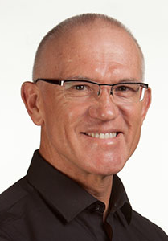
Dr. Mark Keown The pacification of the known world by the Romans was known as the pax Romana/ Augusta. The ideology of universal peace and prosperity under

Slide 31
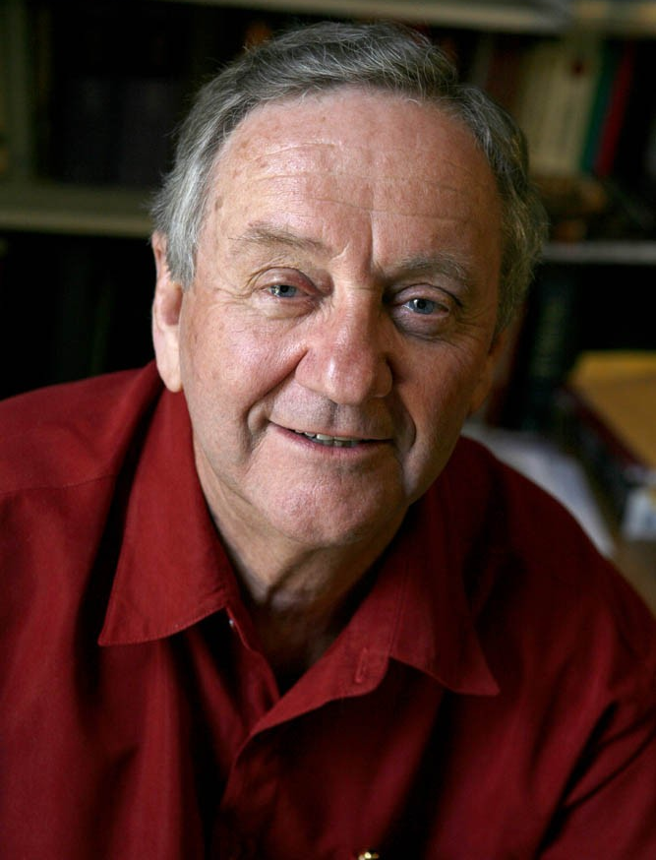
Dr. Peter T. O’Brien The pacification of the known world by the Romans was known as the pax Romana/ Augusta. The ideology of universal peace and prosperity under

Slide 32
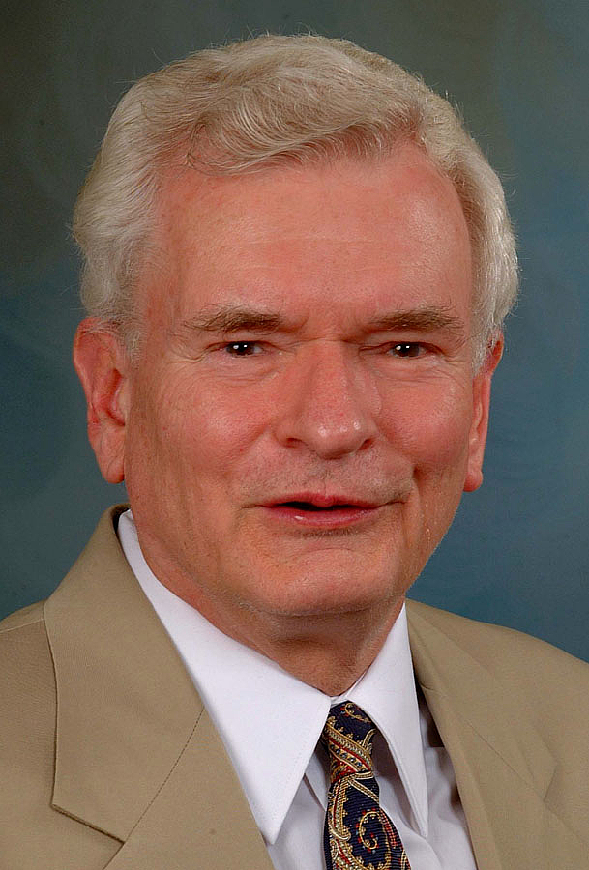
Dr. John Reumann Christ Jesus provides the basis for their relation to God, “glue” for their connections with each other, the sphere for their life and endeavors

Slide 33
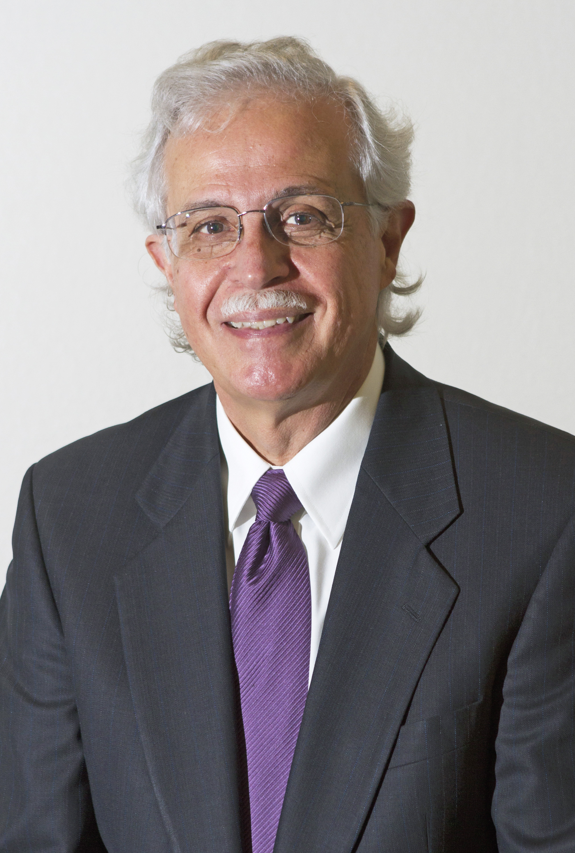
Dr. Moises Silva Christ Jesus provides the basis for their relation to God, “glue” for their connections with each other, the sphere for their life and endeavors

Slide 34
Jen Wilkin The heart cannot love what the mind does not know.

